Slide 1
Wellnomics Indoor Positioning System
By Aryan Srivastava

Slide 2
Sound
SPL
Attenuation
Hardware
Noise
Frequency

Slide 3
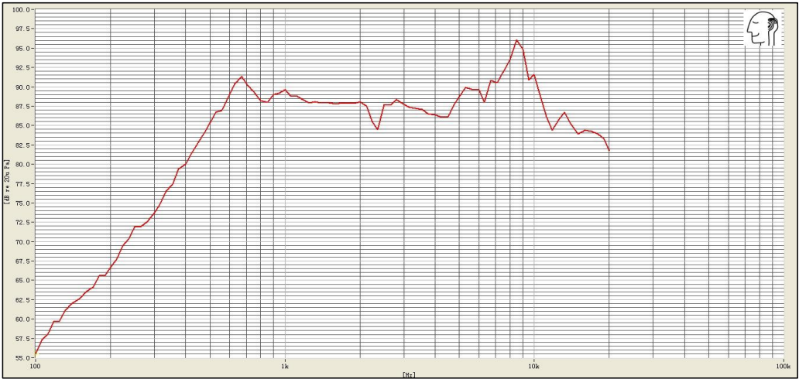
Hardware - Speaker

Slide 4
Hardware - Mic

Slide 5
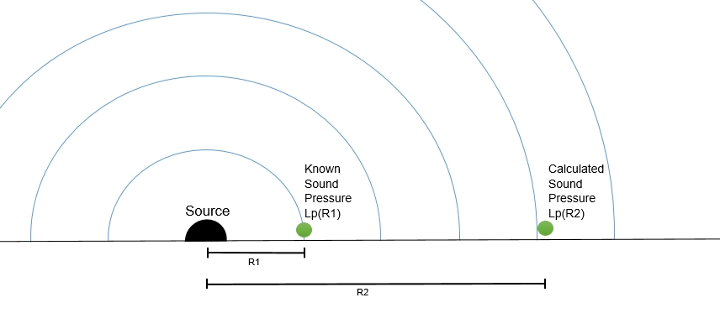
Attenuation - Distance
Inverse Square Law
Lp(R2) = Lp(R1) - 20log(R2/R1)
Noise Floor (Mic) : 28.5 dB
Max theoretical distance : 118 m

Slide 6
Distance Attenuation

Slide 7
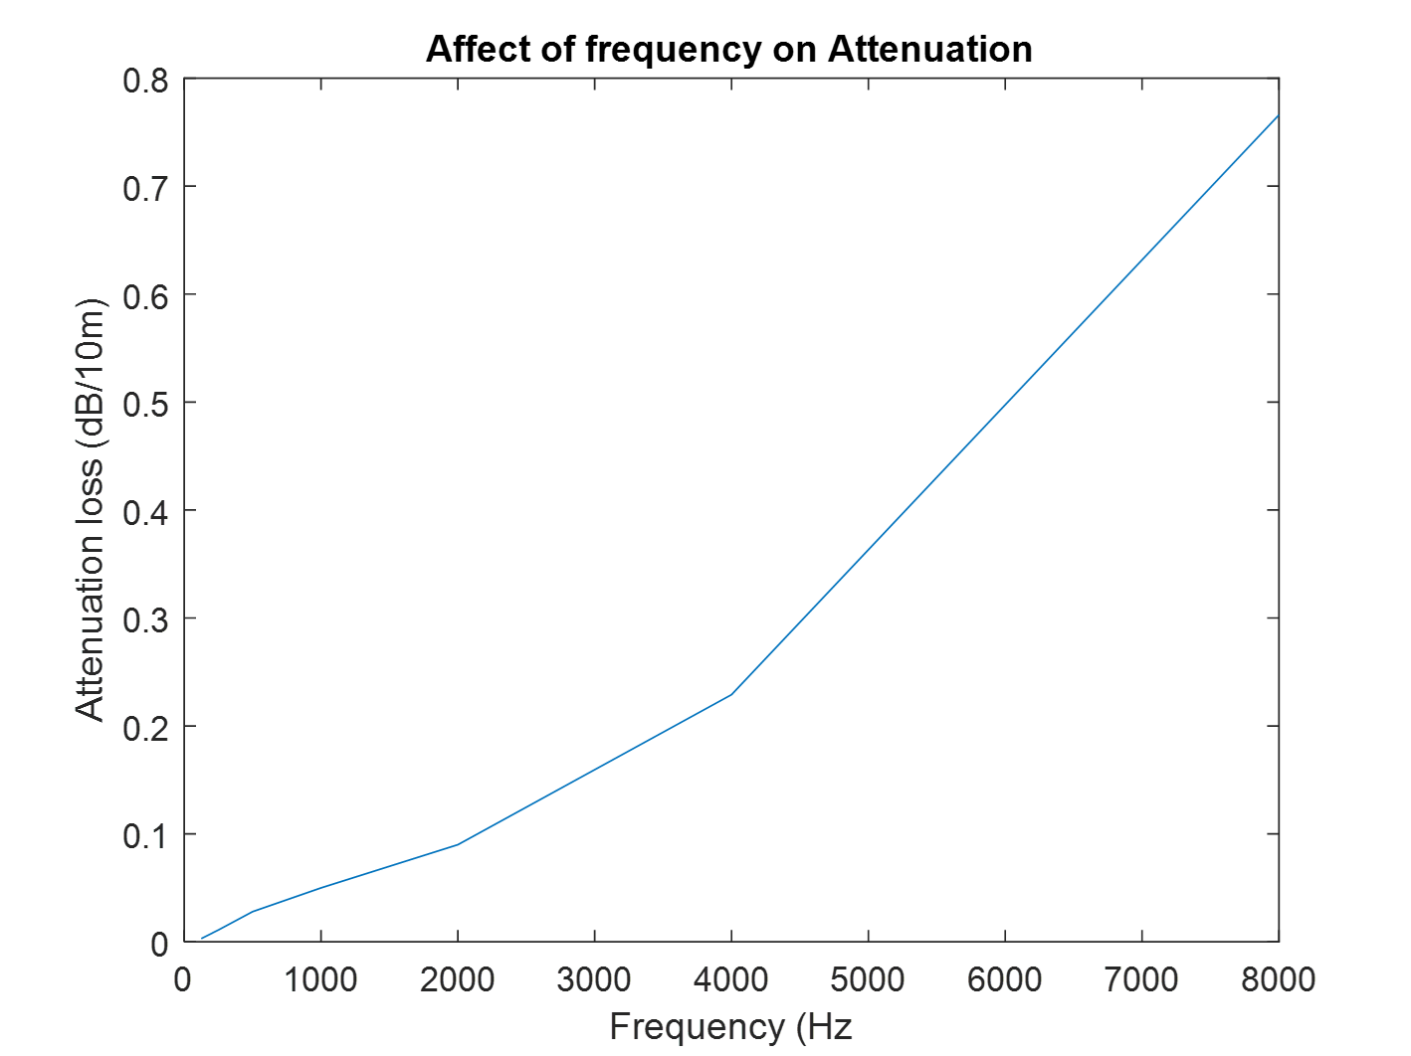
Attenuation - Atmospheric
Attenuation due to atmospheric friction.
Proportional to Frequency

Slide 8
Attenuation - Materials
Materials – Reflective and Absorptive
Absorption scales with frequency.
Proportional for Absorptive
Inversely Proportional for reflective

Slide 9
Attenuation - Simulations

Slide 10
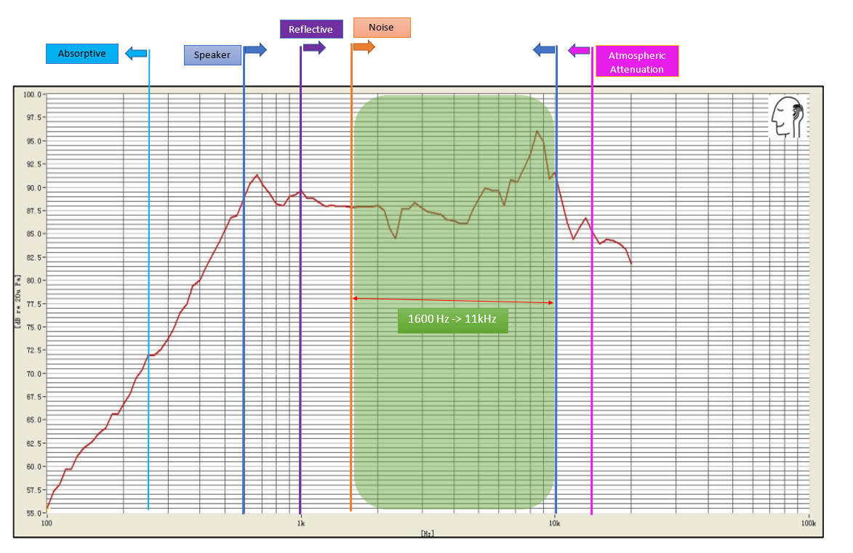

Slide 11
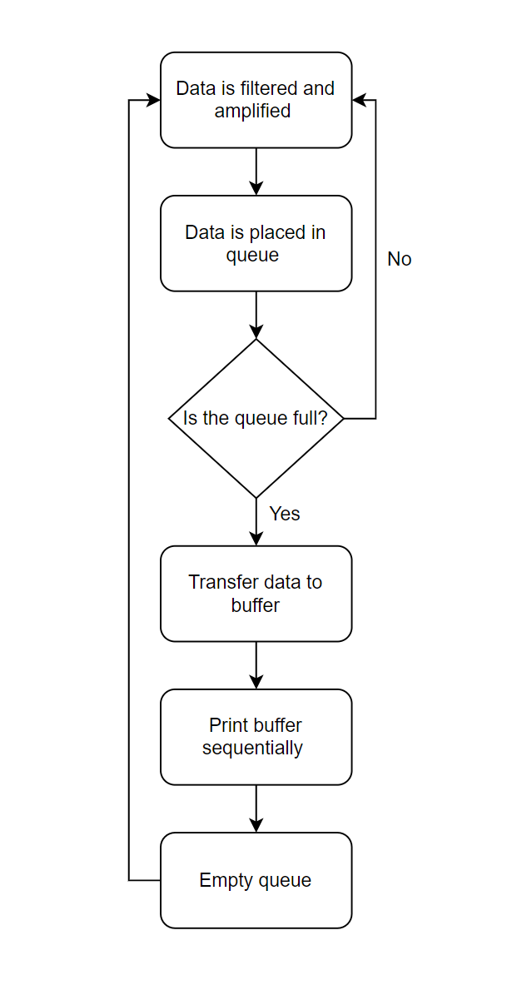
Testing – Code

Slide 13
Testing Result
Max Distance : 18 m
Max Distance (filtered) : 25 m
Best Frequency Range : 9kHz – 10 kHz

